Slide 1
ONTARIO CONSTRUCTION CAREERS ALLIANCE

Slide 2
Civil Construction is the construction of
all roads
bridges
sewer systems
water delivery systems

Slide 4
Construction Labour Shortages
Aging work force in the construction
industry
Many opportunities in the construction
industry.

Slide 5
Construction provides a range of careers
Operators
Labourers
Concrete finishers
Crane Operators
Technician/Technologist

Slide 6
Your construction career can
take you anywhere in the world
Transferable skills = more opportunities
Red Seal Certification

Slide 7
Contribute to a variety of projects that affect the way people live
You can see the results of your work
You will be able to say ‘I helped build that!’

Slide 8
The construction industry welcomes
anyone
Some jobs require no previous
knowledge or experience

Slide 10
The average age of a journeyperson in Canada is over 48.
Canada will need an estimated 319,000 new construction workers from 2012 to 2020
40% of new jobs will be in the skilled trades and technologies
Ontario’s Construction industry currently employs approximately 300,000 people.

Slide 12
Careers in trades pay more after graduation than many graduates of college programs.
Construction workers earn more per hour than many university graduates
Annual salary is higher than the national industry Average.
Apprentice can earn while they learn and avoid debt

Slide 13
The construction industry requires individuals that:
Have great math skills and the ability to solve problems
Create, plan and communicate
Can pay attention to details
Individuals able to use technical equipment
Have a good work ethic and are adaptable
Visualization of the end product

Slide 14
Some positions require more than a high school education
Some positions provide the training on site.
1 of 10 jobs requires a university degree.
students are hired out of school and are provide opportunities to advance their careers

Slide 15
Individuals do work with heavy equipment, power tools and in dangerous situation.
Safety is the number one priority in construction across Canada.
High safety standards must be followed

Slide 16
Women make up 5% of the construction industry.
Women in Skilled trades (WIST)

Slide 17
Working in construction
requires the use of sophisticated equipment such as:
GPS
Trimble
Smart Phones
AutoCAD

Slide 19
Apprenticeship Program
combining on the job training with technical in class training.
University or College
technical end (estimating, engineering, etc.)
Labourer
Take your resume to local construction companies and learn the skills you will require hands on

Slide 20
Heavy Equipment Operators
Construction Craft Workers
Concrete Finishers
Carpenters
Hoisting Engineers (Crane Operators)
Heavy Duty Equipment Mechanic
40-50% of skilled trade workers work in construction

Slide 21
Find An employer
Pre-apprenticeship program at a community college
Apprenticesearch.com
Register with the MTCU for an apprenticeship with an employer
Spend 90% of your time learning hands on in the field and 10% in a classroom
Write a certification exam
Write the red seal certification exam

Slide 22
Ontario youth Apprenticeship Program offers secondary school an opportunity to gain experience and skills for apprenticeship qualifications, while earning credits to complete Ontario Secondary School Diploma.

Slide 23
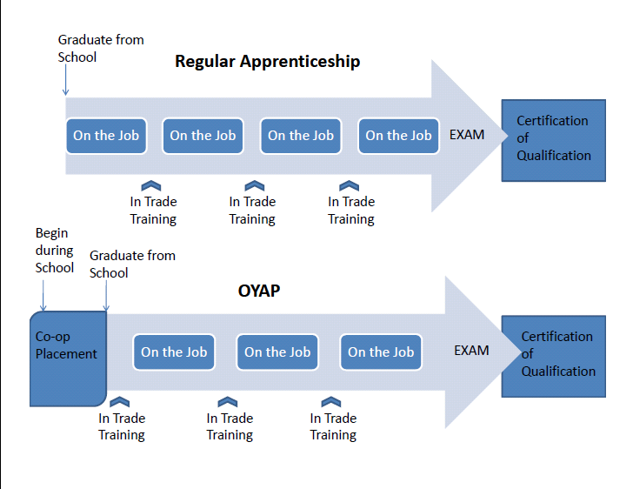

Slide 24
Visit our website for more information www.myOCCA.ca and to try our Career Survey

